Slide 1
Application of Priority Queue and Heap
By Ethan Jelo P. Martinez

Slide 2
Question
Given a N x N matrix, where every row and column is sorted in non-decreasing order. Find the kth smallest element in the matrix.
Input:
N=4
Mat[][] = {{16,28,60,64},
{22,41,63,91},
{27,50,87,83},
{36,78,87,94}}
K = 3
Output: 27
Explanation: 27 is the 3rd smallest element
https://practice.geeksforgeeks.org/problems/kth-element-in-matrix/1

Slide 3
Solution:
There are two ways of solving this problem which is binary search or binary tree specifically a MIN-HEAP

Slide 4
01
Components of a Min Heap
x
y

Slide 5
01
Push
02
Pop
03
PercolateDown
04
PercolateUp
05
Helper Functions
Adds an item to a heap while maintaining its heap property
Removes an item from a heap while maintaining its heap
Restores the heap property from a child node to a root node.
Restores the heap property from a root node to a child node
Functions that allow the system to work

Slide 6
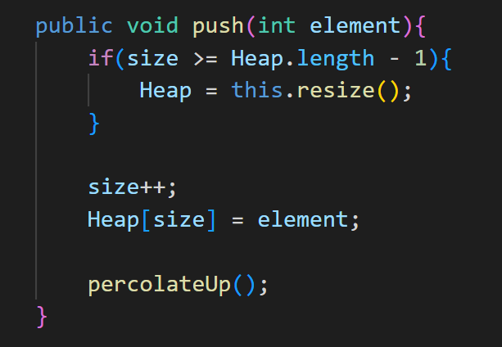
Push
Adds a value to the min-heap.

Slide 7
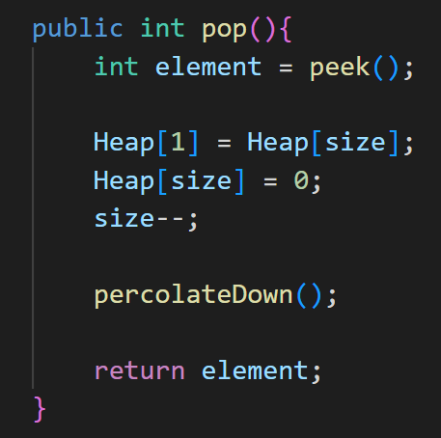
Pop
Removes and returns the minimum element in the heap.

Slide 8
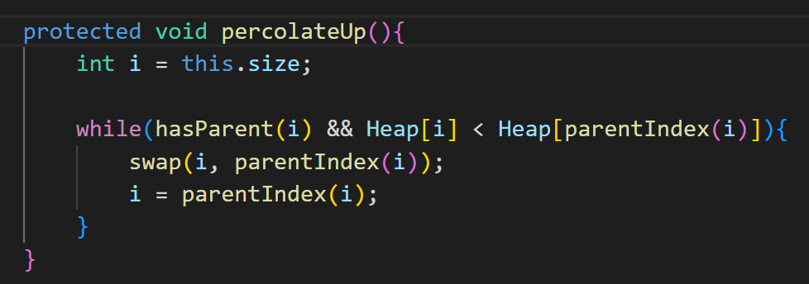
PercolateUp
Place a newly inserted element in its correct place so that the heap maintains the min-heap order property.

Slide 9
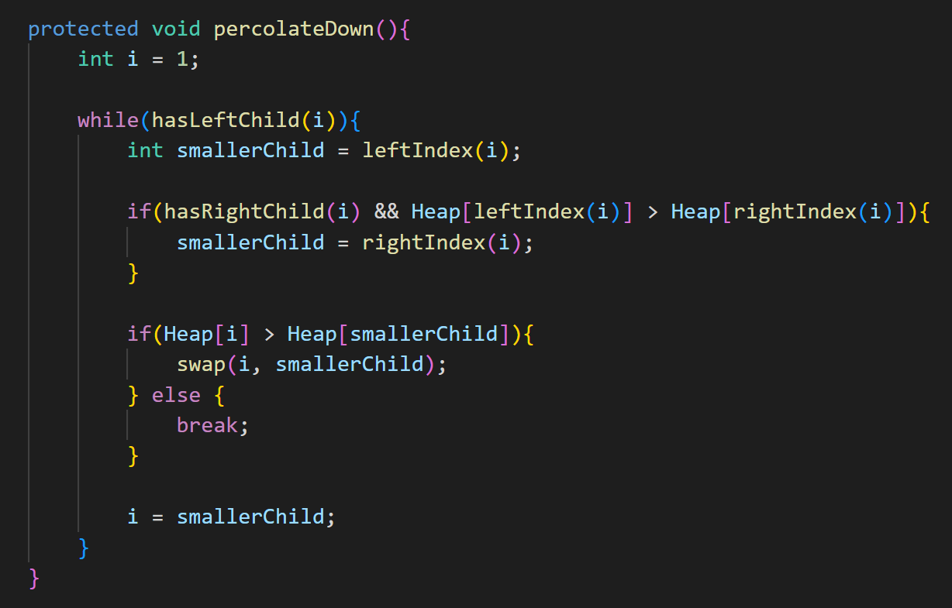
PercolateDown
place the element that is at the
root of the heap in its correct place so that the heap maintains the
min-heap order property.

Slide 10
Helper Functions
x
y

Slide 11
01
Peek
02
Swap
03
Resize
04
Constructor
05
Index Functions

Slide 12
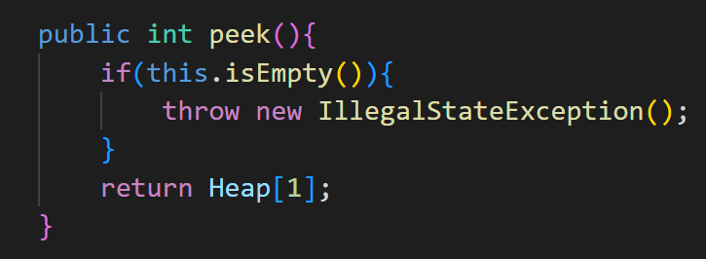
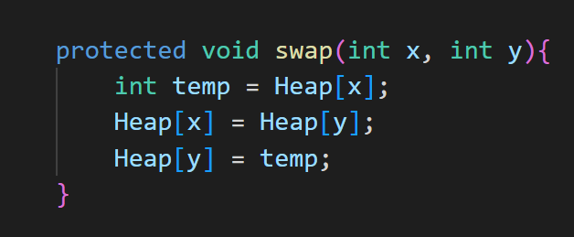
01
Peek
02
Swap

Slide 13
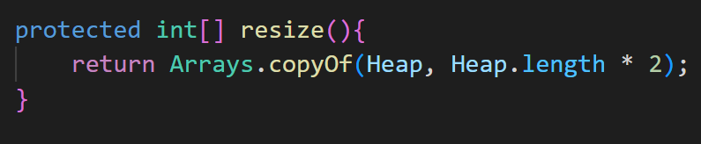
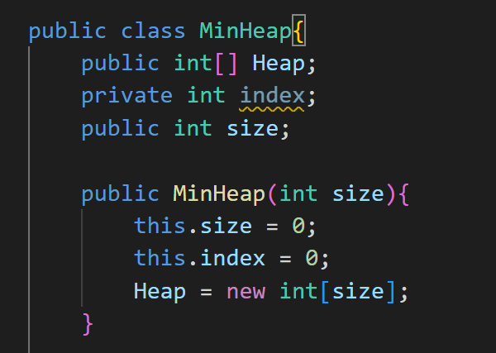
03
Resize
04
Constructor

Slide 14
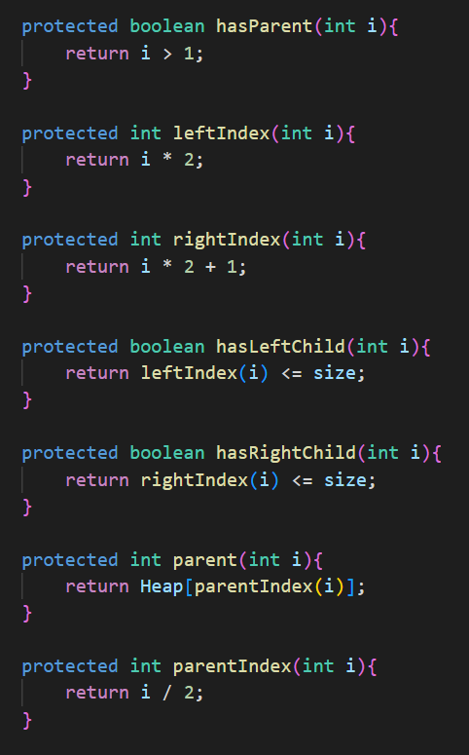
05
Index Functions

Slide 15
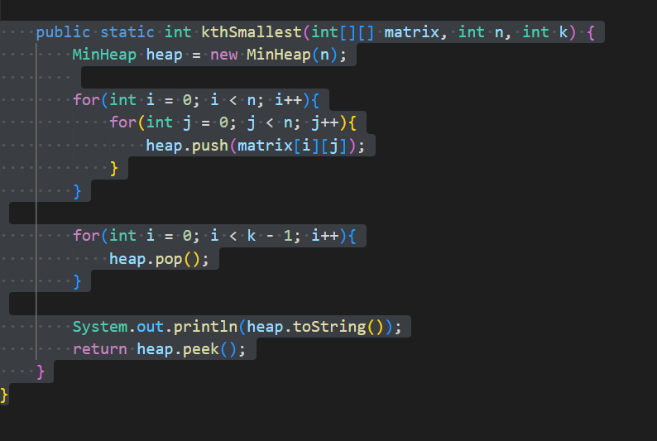
Answer to the Question

Slide 16
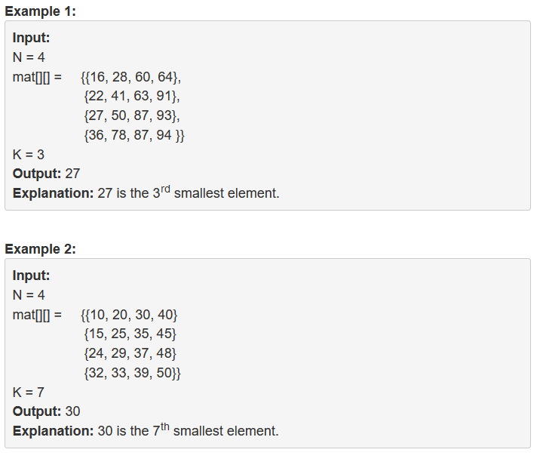
Answers

